Slide 1
AI-frukost – Kort och konkret om Artificiell Intelligens här och nu
AI breakfast – short and comprehensible about AI here and now

Slide 2
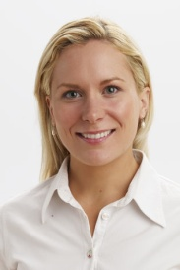
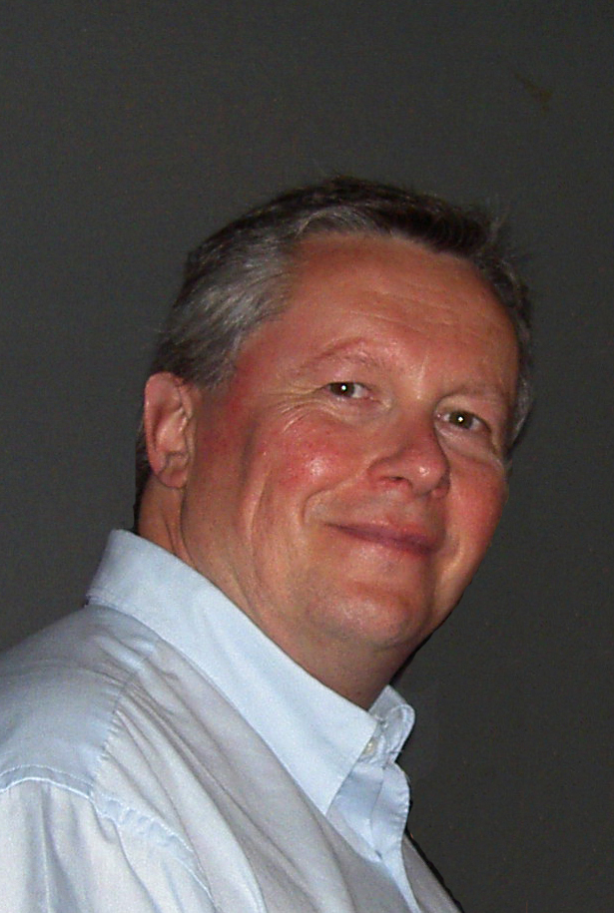
Marie Nolin
Datacenter Innovation
Region
Leif Häggmark
SSiO
Skelleftea Digital
Alliance

Slide 3
Then, what is AI?
Vinnova made a report - Artificiell intelligens i svenskt näringsliv och samhälle - Analys av utveckling och potential
Vinnova Serie: Vinnova Rapport VR 2018:08
Where they say that there is no unambiguous definition or generally accepted definition of AI.
But, in there analysis, they define AI as the ability of a machine to mimic intelligent human behavior.

Slide 4
Potential?
• Automate functions in established value chains, operations and functions
• Develop new business models, goods, services and system solutions
• Transform value chains and sectors into completely new development tracks

Slide 5
New challenges
• Leadership and adaptability in companies, public activities and policy systems
• Job dynamics and unemployment due to rapid changes in tasks
• Ownership of data and challenges with personal integrity, ethics and trust
• Data and business monopoly for a few technology-based companies
• Risk of application of immature AI solutions based on erroneous data and algorithms
• Security risks through deliberately harmful data usage and data manipulation

Slide 6
Areas where AI will have a great impact
• Industrial development
• Travel and transport
• Sustainable and smart cities
• Health
• Financial services
• Security

Slide 7
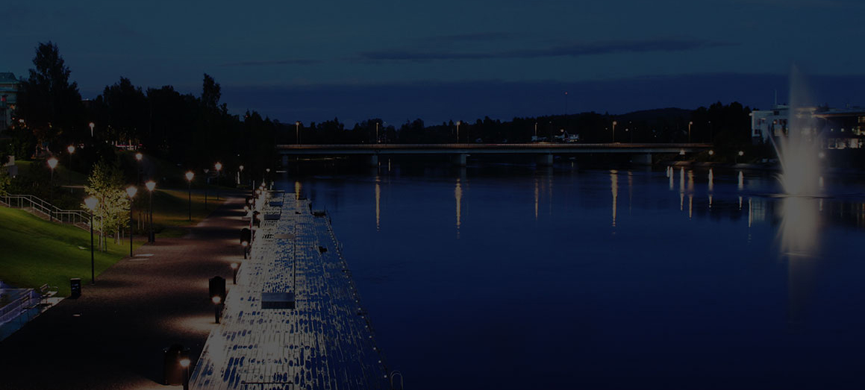
Societal development through Secure IoT and Open Data (SSiO)
Luleå University of Technology Skelleftea Digital Alliance
Data Ductus Skellefteå Kraft
Sokigo Skellefteå municipality
BI Nordic
CGI
So, what is the SSiO project doing regarding AI?

Slide 8
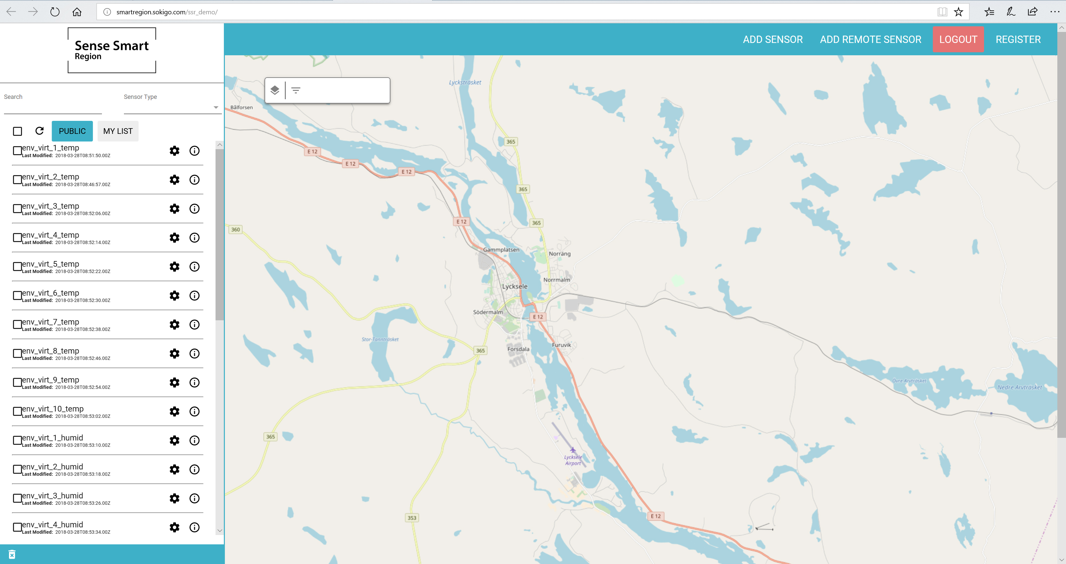
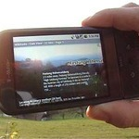
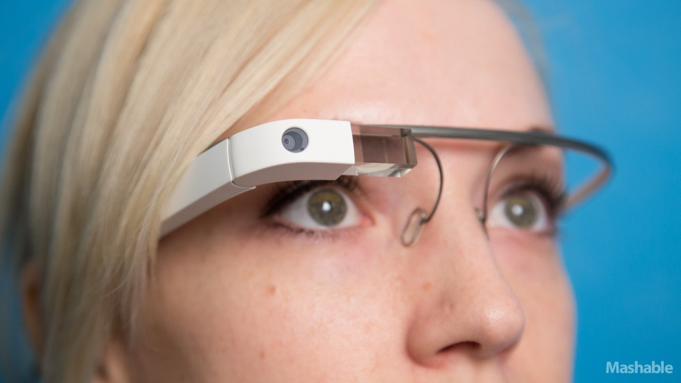
We built an open IoT platform in our former project SenseSmartRegion
Possibility of connecting IoT devices over any internet connection, or our own LoRa network. Authentication.
Possibility to bring in open data, e.g. from municipalities.
Ability to manage geographic information about available data.
Map based GUI
A presentation part where information can be presented as AR,
i.e. as an overlaid picture on top of reality.

Slide 9
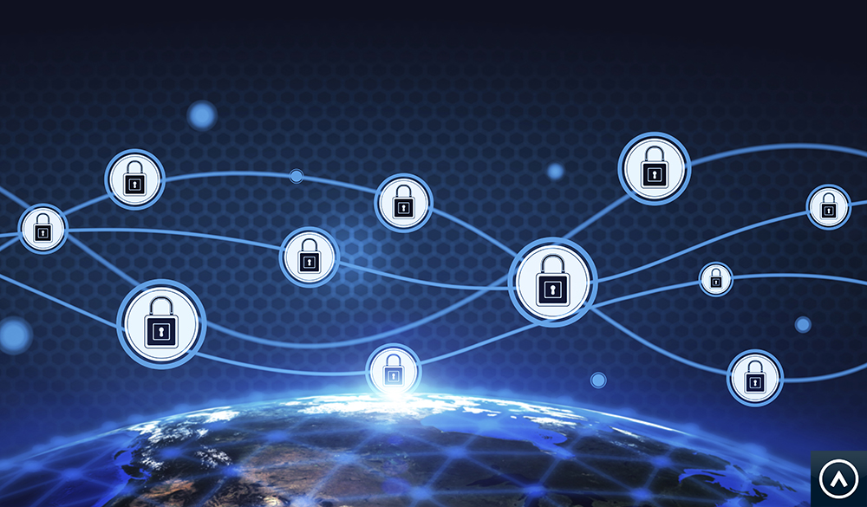
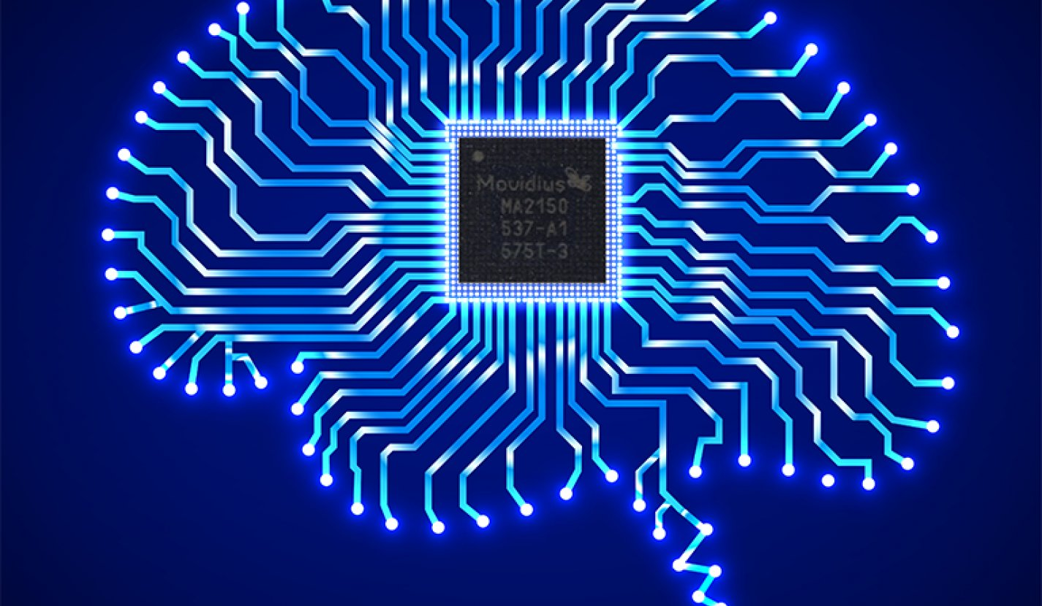
Now we are developing the platform further
We focus even more on IoT security in our new project, e.g. We will monitor communication to ensure that no one has hacked in and taken over your device.
We work with machine learning to automatically recognize what are normal patterns in data, and what are deviations.

Slide 10
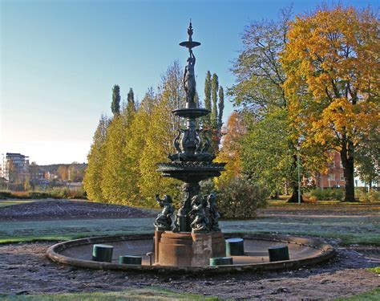
Chatting with dead objects
For instance chat with ”Johanna i parken”
An AI chat bot interpretes your question and chooses among predefined humurous answers.

Slide 11
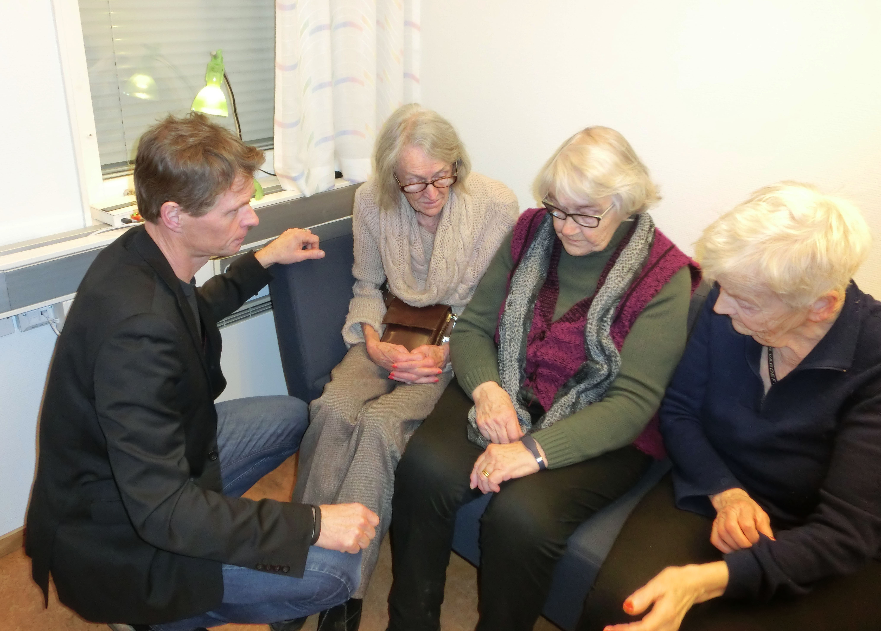
Elderly care
Together with the IVo project, (run by Skellefteå municipality), we equipped a number of homes with sensors, (doors, motion, television set, coffey machine, bed lamp and water consumption).
BI Nordic and LTU are working with a machine learning solution that will detect deviations from the normal pattern, and trigger a message to a relative, or ”hemtjänsten”.

Slide 12
IoT security
BI Nordic and LTU are also working together in the SSiO project to detect intrusion in IoT devices.
They will use machine learning to analyze the communication patterns from connected IoT devices, and detect anomalies.

Slide 13
Datacenter Innovation Region provides an opportunity for small and medium-sized enterprises, with operations in Norrbotten and Västerbotten, to gain support for the development of products and services in the field of data centers and clouds.
www.datacenterinnovationregion.se

Slide 14
The project can provide support: 1) To define, develop, test and demonstrate new and better products and services 2) For external work and services for research, development and innovation 3) For fees and expenses for equipment and test environments

